Slide 1
Structured Query Language (SQL)
Project#1
Presented By:
Jangid Kavita

Slide 2
Introduction
With the intention to build SQL project portfolio, I have created this presentation.
In this project I have created a database containing few tables and performed some tasks to demonstrate my SQL abilities.
For this project, Data collected from a online platform.
Here for running SQL queries, I have used MySQL Workbench 8.0.31.

Slide 3
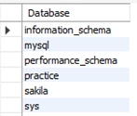
List available Databases.
For listing the databases available in the system.
SHOW DATABASES / SHOW SCHEMAS
Input Query
Output

Slide 4

Create New Database
Firstly, I have created a new database namely ‘Walmart’.
It consist of four tables which are as follows:
Sales Table
Customer Table
Product Table
Address Table
In next few slides I have created all the four tables.
Input Query

Slide 5


Customer Table
Attributes are as follows :
Customer ID
Customer Name.
Input Query
Output

Slide 6
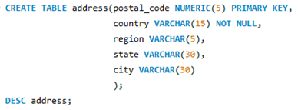
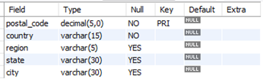
Address Table
List of attributes :
Postal Code
Country
Region
State
City
Input Query
Output

Slide 7
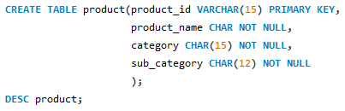

Product Table
List of attributes :
Product ID
Product Name
Category
Sub Category
Input Query
Output

Slide 8
Sales Table
It includes following Attributes:
1. Row ID | 8. Postal Code
2. Order ID | 9. Product ID
3. Order Date | 10. Sales
4. Ship Date | 11. Quantity
5. Ship Mode | 12. Discount
6. Customer ID | 13. Profit
7. Segment

Slide 9
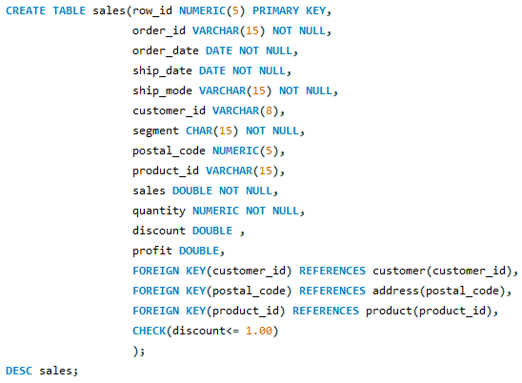
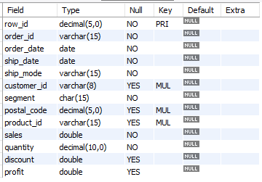
Input Query
Output

Slide 10


ALTER Table Command
In Product table, change datatype of Product name from CHAR to VARCHAR.
Input Query
Output

Slide 11
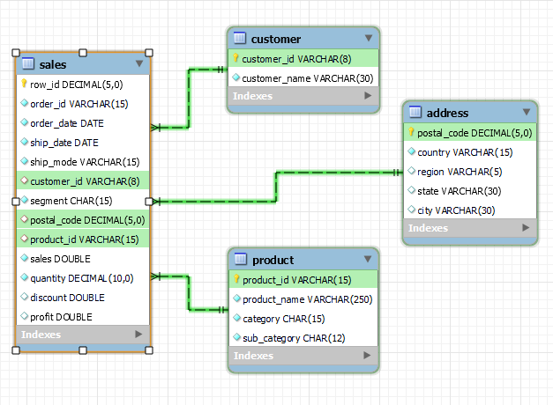
EER Diagram

Slide 12

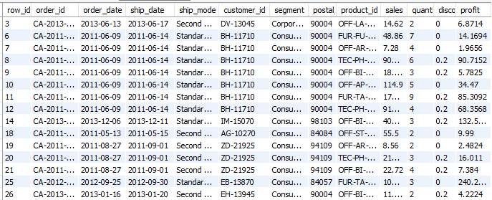
Task#1 Find all information about each Sales.
Input Query
Output

Slide 13

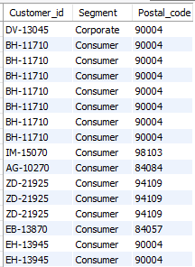
Task#2 Find the Customer ID, Segment and Postal Code from Sales.
Input Query
Output

Slide 14


Task#3 List all the segments (no duplicates).
Input Query
Output

Slide 15
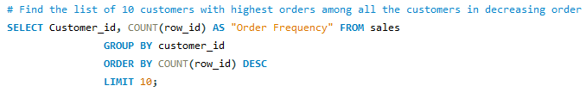
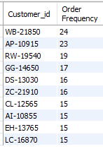
Task#4 Find the list of 10 customers with highest orders among all the customers in decreasing order.
Input Query
Output

Slide 16
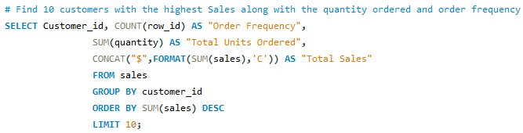
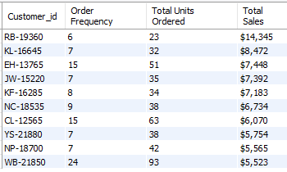
Task#5 Find the list of 10 customers with the highest Sales along with the quantity ordered and order frequency.
Input Query
Output

Slide 17
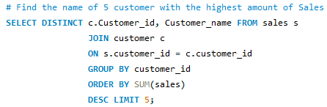
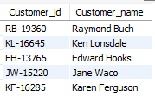
Task#6 Find the name of 5 customer with the highest amount of Sales.
Input Query
Output

Slide 18
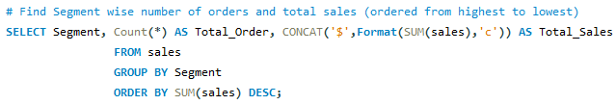

Task#7 Find Segment wise number of orders and total sales (ordered from highest to lowest).
Input Query
Output

Slide 19
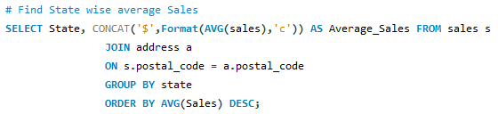
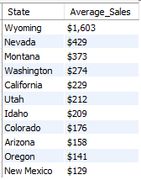
Task#8 Find State wise average Sales.
Input Query
Output

Slide 20

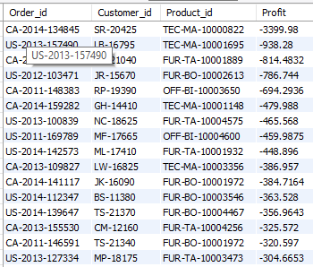
Task#9 Find all the Loss making sales.
Input Query
Output

Slide 21
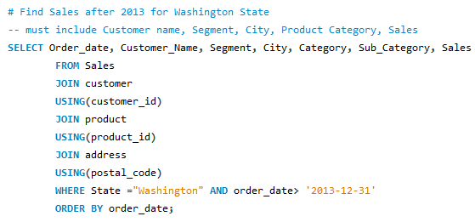
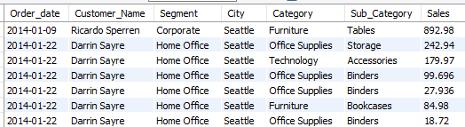
Task#10 Find Customer name, Segment, City, Product Category and Sales after 2013 for Washington State.
Input Query
Output

Slide 22
Thank You

